Slide 1


Strategic Merger Analysis of LioCinema and Jotstar
- Data-Driven Insights for a Leading OTT Platforms in India
Presented by: Peter Pandey, Data Analyst at Lio
Date: February 2025

Slide 2
Introduction
Objective: Provide actionable insights for Lio and Jotstar’s potential merger, aiming to create the leading OTT platform in India.
Goal: Analyze key factors like content library, subscriber behavior, inactivity, and usage patterns to optimize the merger strategy.

Slide 3
Problem Statement
Challenge: Lio (telecom) and Jotstar (streaming) need to combine their strengths: Lio’s extensive subscriber base and Jotstar’s vast content library. The merger aims to capture the OTT market in India.
Focus Areas:-
Content Library
Comparison Subscriber Acquisition and Demographics
Inactivity Behavior Analysis
Content Consumption and Engagement

Slide 4
Data Overview
Dataset Summary: Key metrics extracted from the user and content data from January-November 2024.
Subscribers Data: Acquisition, demographics, activity status
Content Data: Types, consumption patterns, user interaction
Subscription Trends: Upgrades, downgrades, and behavior changes
Data Tools Used: SQL and Power BI

Slide 5
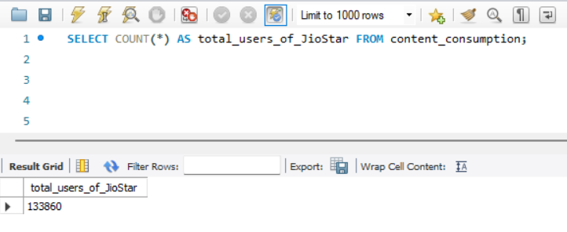
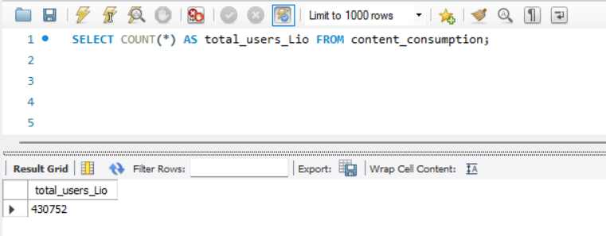
Total Users

Slide 6
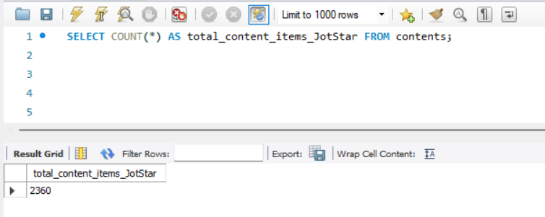
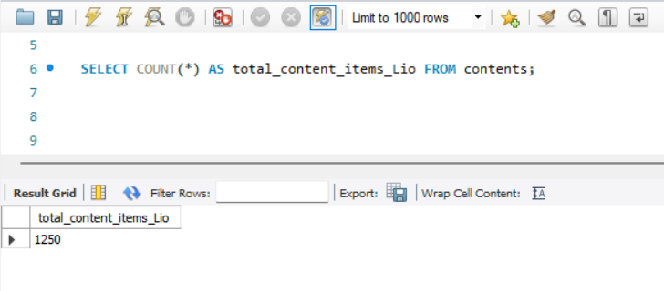
Total Content Items

Slide 7
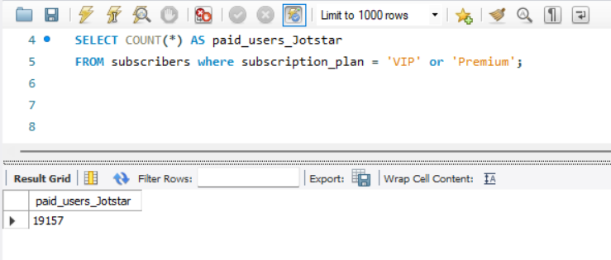
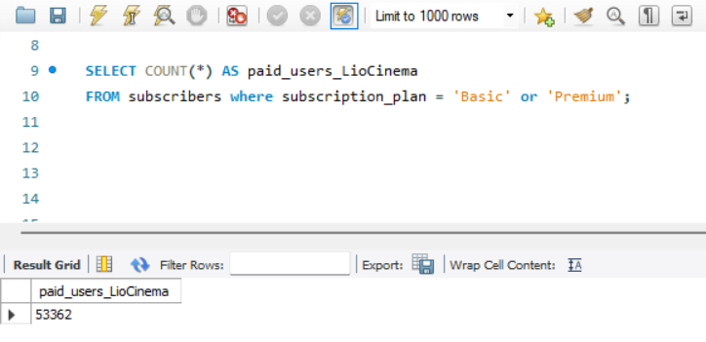
Total Paid Users

Slide 8
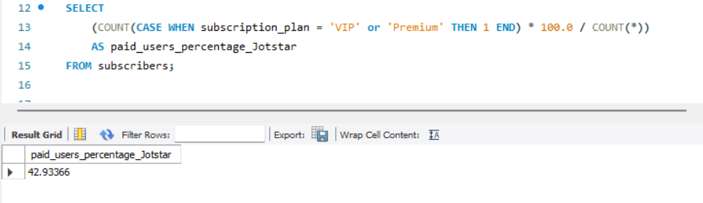
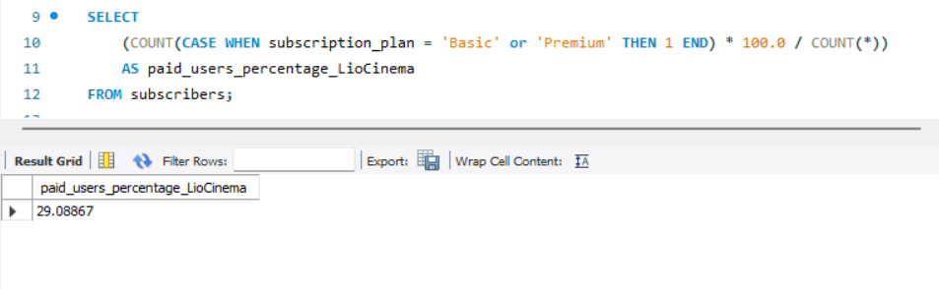
Paid Users Percentage

Slide 9
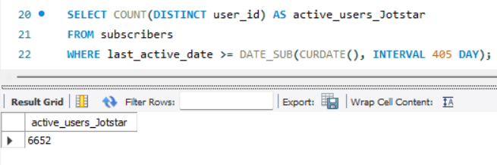
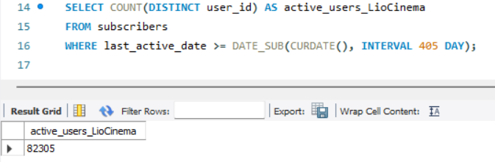
Total Active Users
Last year 2024 = 365 days
This year 2025 = 40 day
365+40=405 days interval

Slide 10
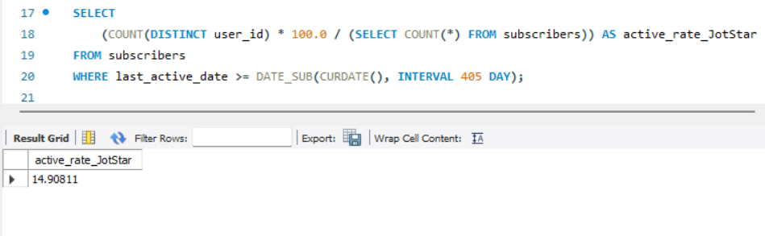
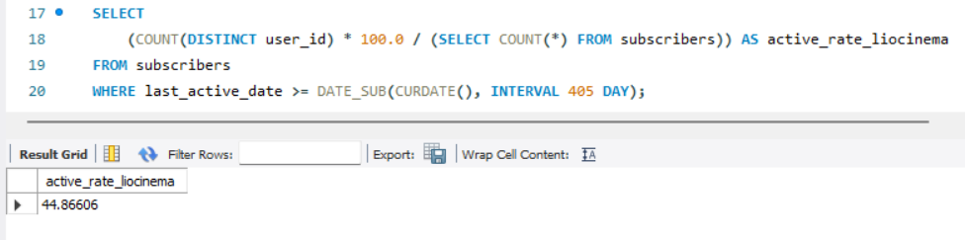
Active User Rate
Last year 2024 = 365 days
This year 2025 = 40 day
365+40=405 days interval

Slide 11
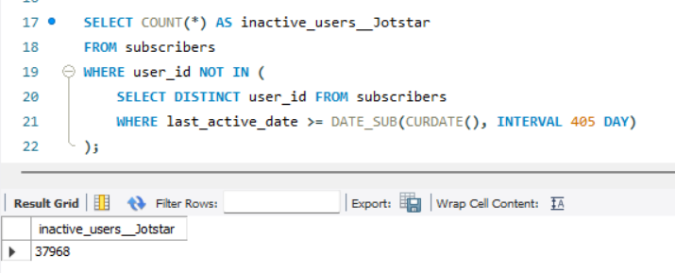
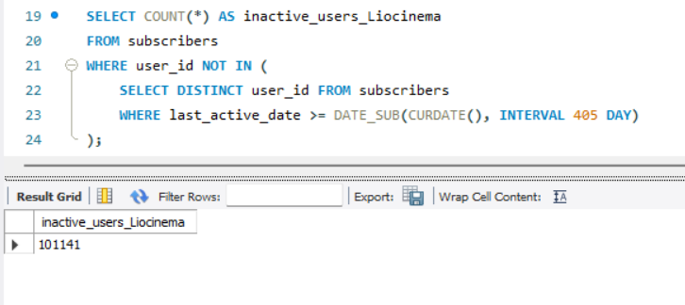
Total Inactive Users
Last year 2024 = 365 days
This year 2025 = 40 day
365+40=405 days interval

Slide 12
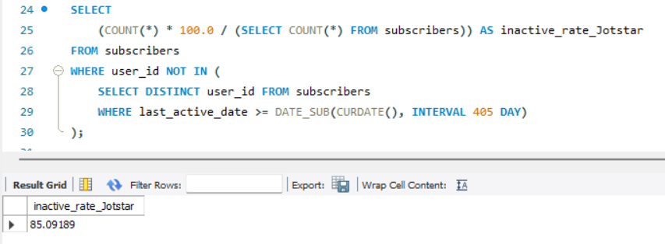
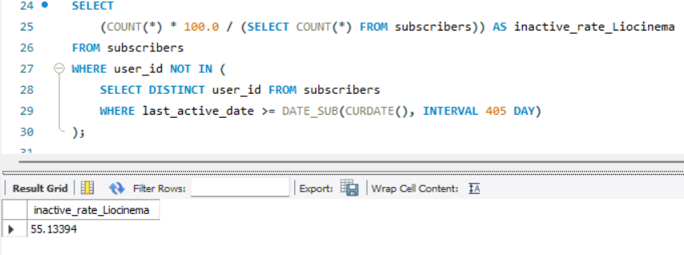
Inactive Rate
Last year 2024 = 365 days
This year 2025 = 40 day
365+40=405 days interval

Slide 13
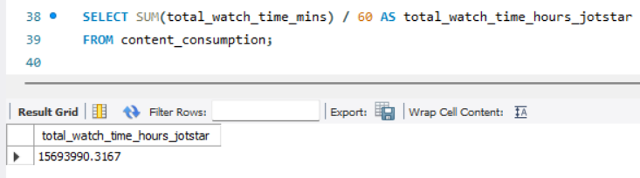
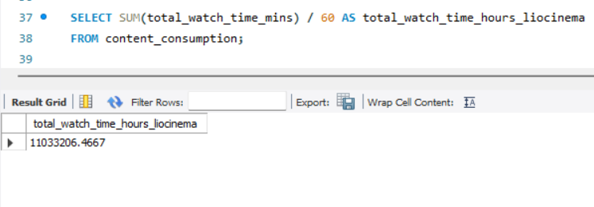
Total Watch Time (mins)

Slide 14
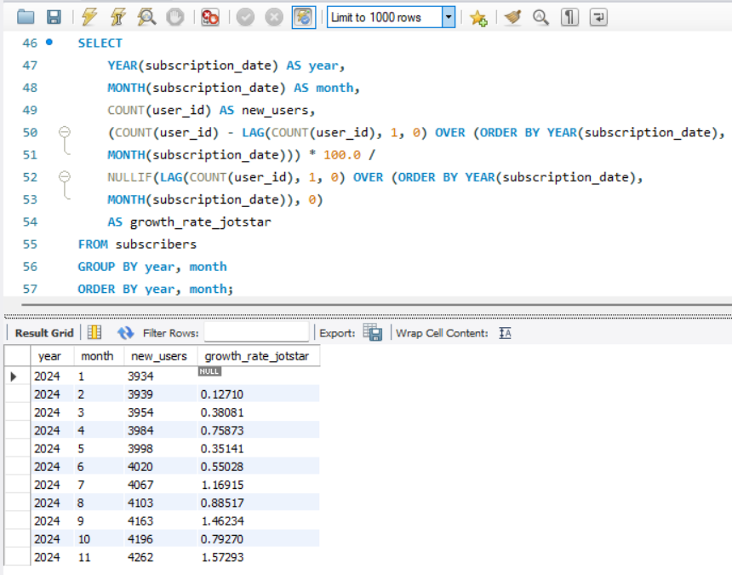
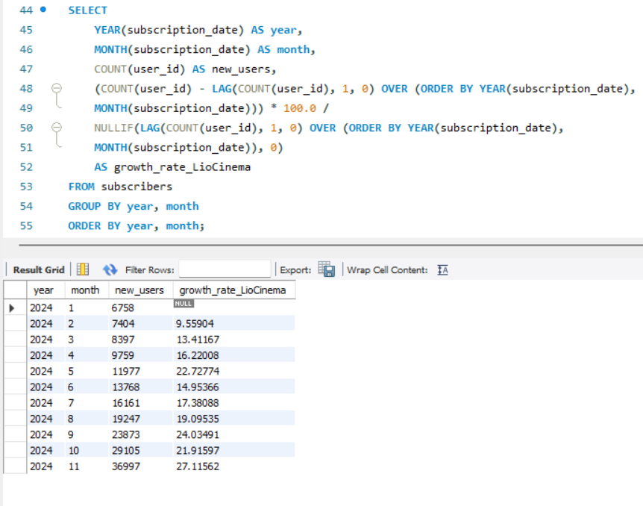
Growth Rate per Month

Slide 15
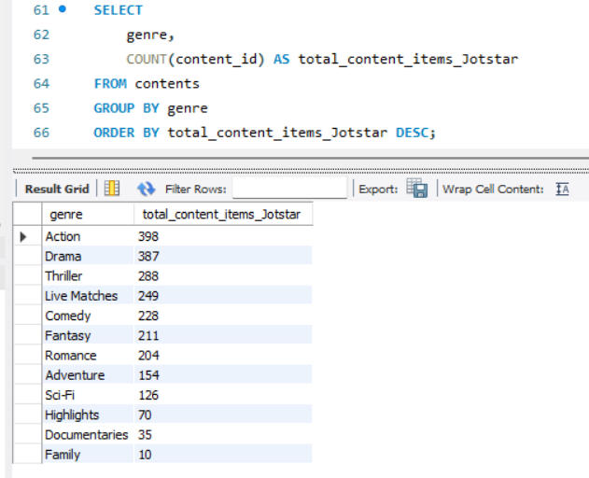
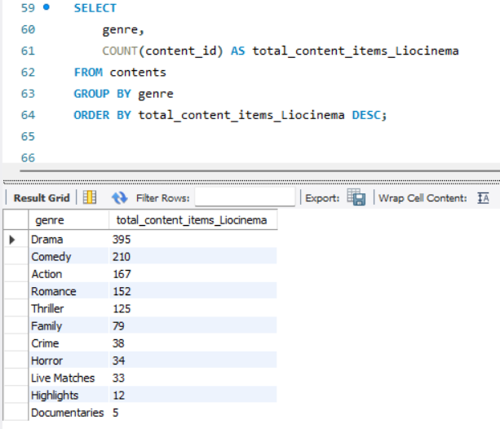
Content Library Comparison by Content Types

Slide 16
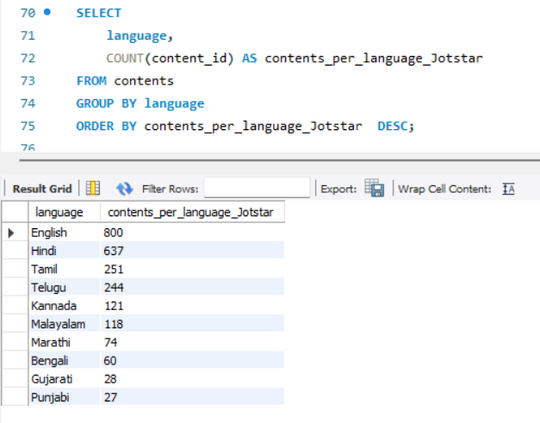
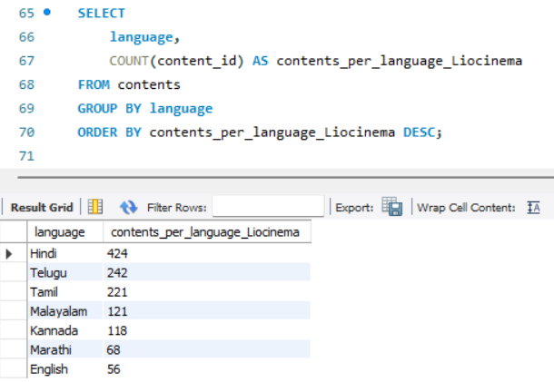
Content Library Comparison by Content Language

Slide 17
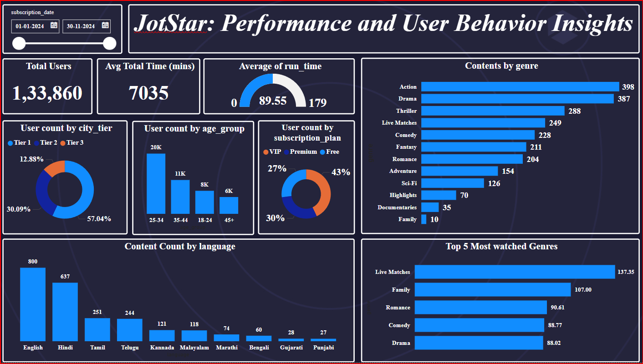

Slide 18
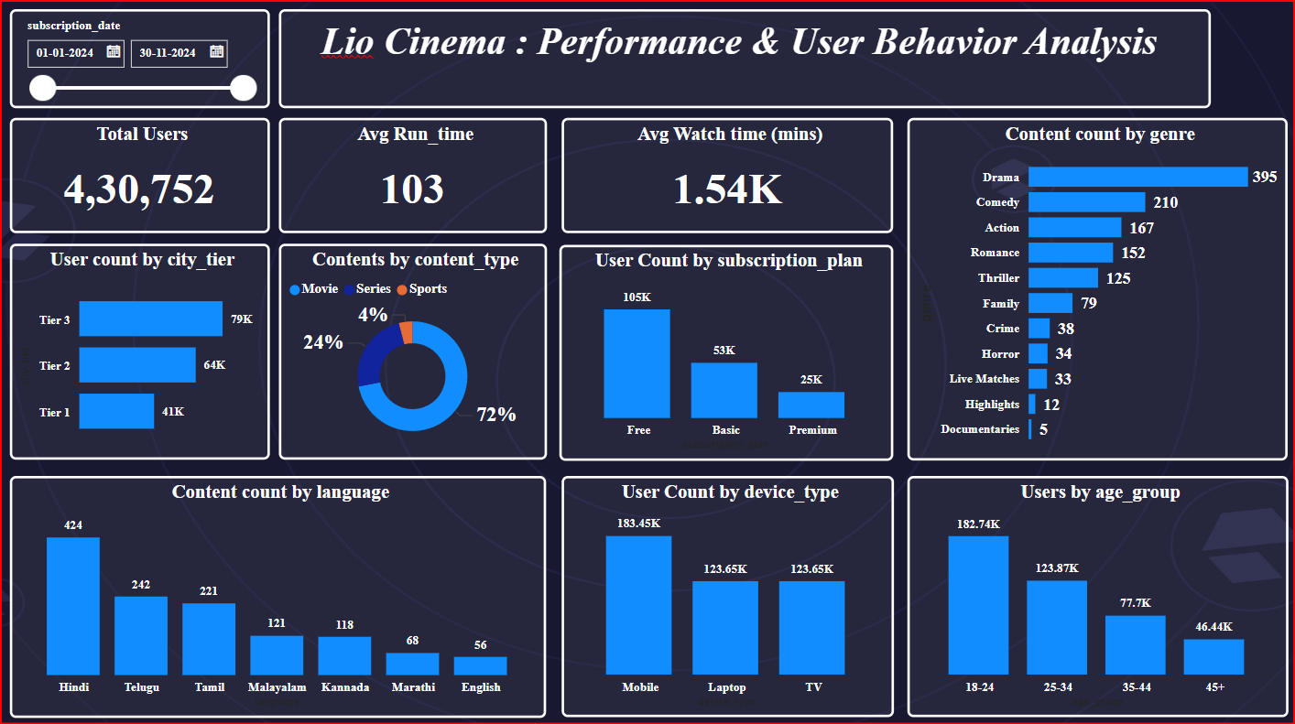

Slide 19
Further Analysis and Recommendations
Engagement Strategies: Target inactive users with personalized campaigns (e.g., trial extensions, customized content).
Brand Campaigns: Focus on emotional storytelling, and emphasize cultural relevance for regional audiences.
Pricing: Introduce bundled plans for telecom users, and competitive pricing for metro and tier-2 cities.
Partnerships: Strengthen ties with telecom companies to drive new user acquisition.
AI & ML: Utilize data for smart recommendations and to enhance customer experience.
Brand Ambassador: Choose a popular Indian actor/actress who resonates with both younger and older generations.

Slide 20
Conclusion
Key Takeaways:
The merger presents an exciting opportunity to lead the Indian OTT market.
Data-driven strategies will optimize content, pricing, and user engagement.
Personalization and strategic partnerships will be crucial for success.
Next Steps: Focus on integrating platforms, testing strategies, and scaling operations.

Slide 21
Thank you
Thank you for your attention. Looking forward to the next steps in making Lio-Jotstar the leader in OTT streaming in India
Contact Details: Peter Pandey | Data Analyst | peter@lio.com

